Slide 1

amazon dashboard
View in Power BI
Last data refresh:
6/13/2025 12:53:52 PM UTC
Downloaded at:
6/14/2025 10:51:33 AM UTC

Slide 2
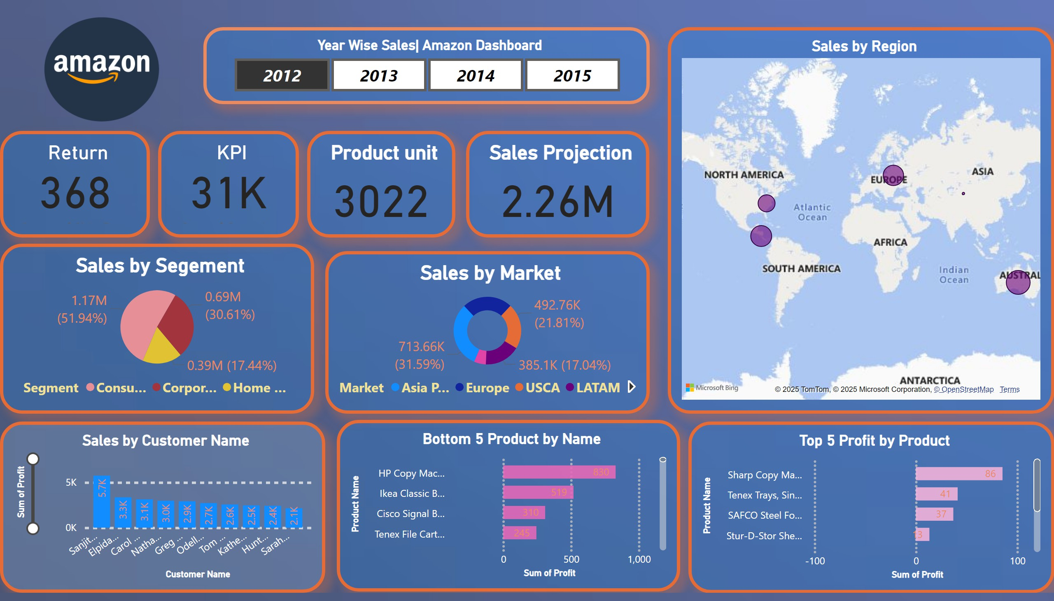

Slide 3
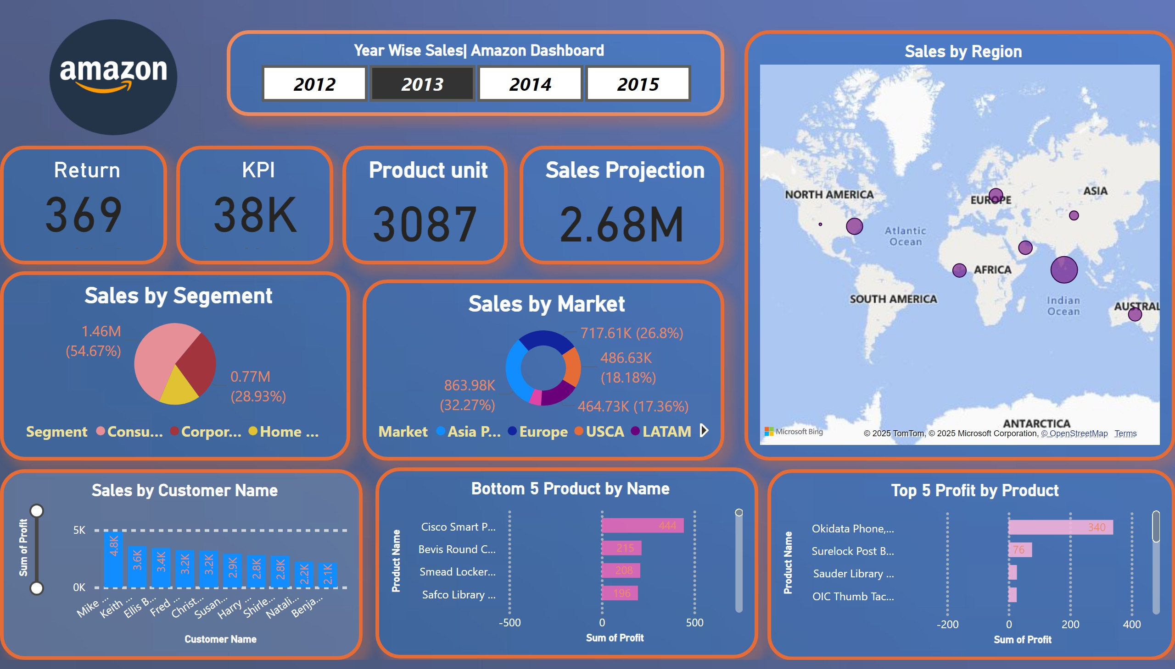

Slide 4
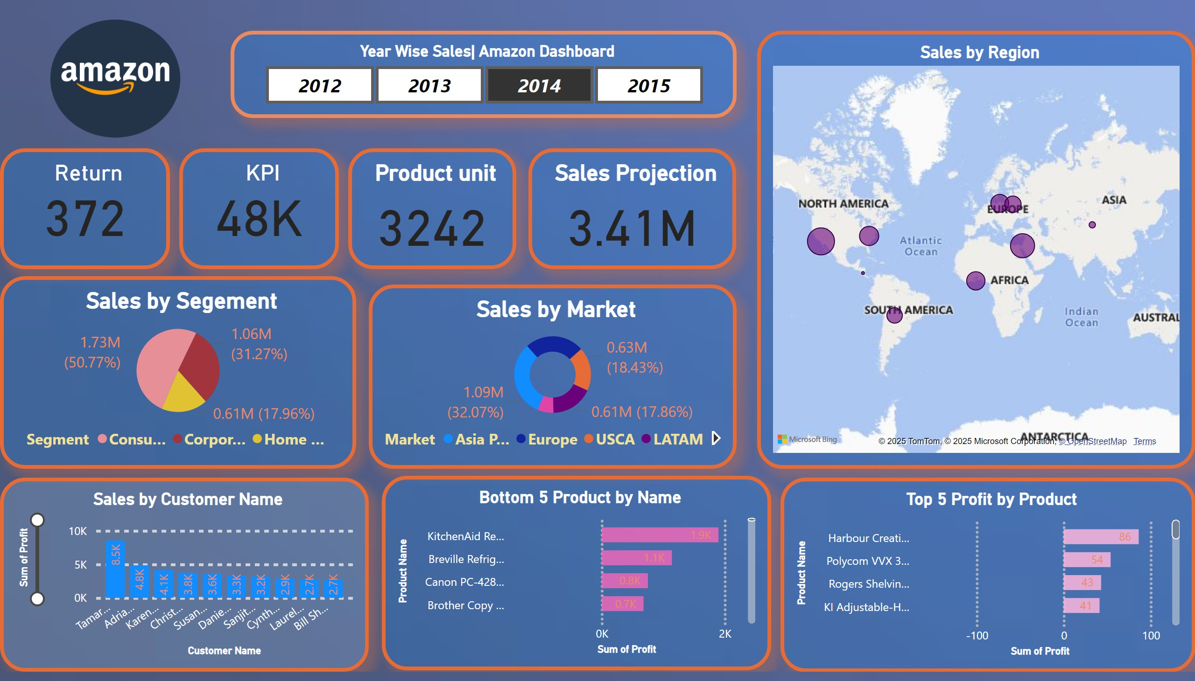

Slide 5
